Slide 1
Paco Basic overview –L1

Slide 2
What is 2G 3G 4G and upcoming 5G

Slide 3
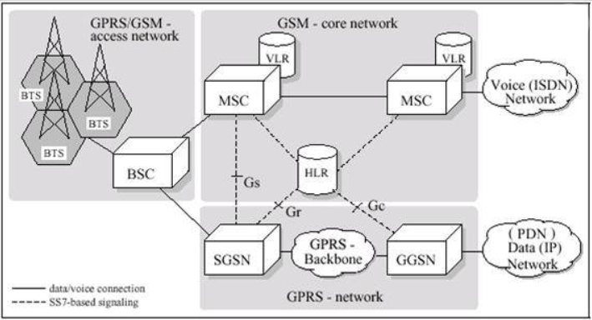
2G Architecture

Slide 4
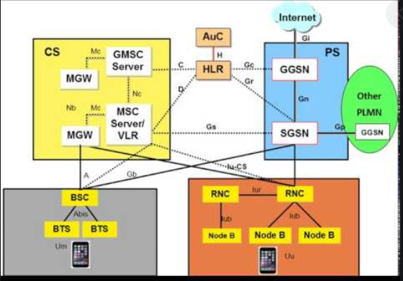
2G & 3G

Slide 5
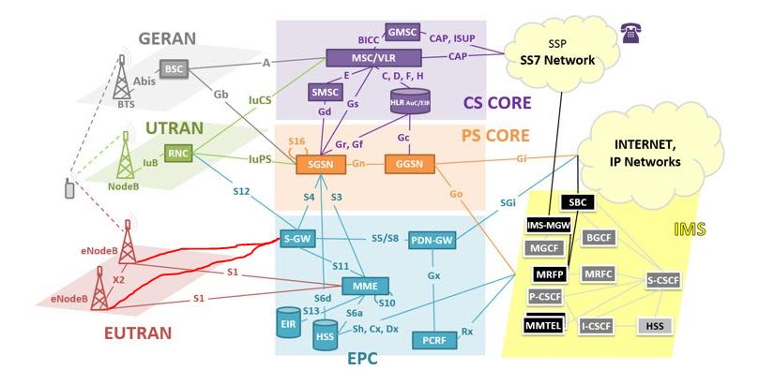
2G , 3G and 4G

Slide 6
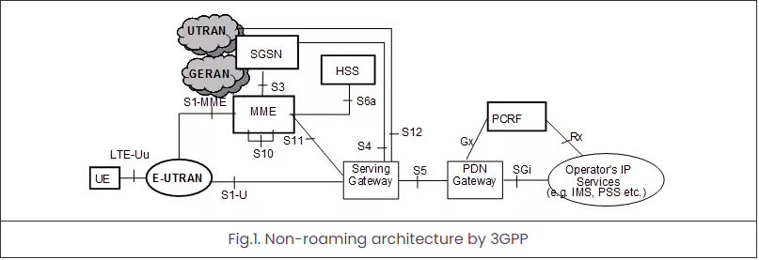
Home 4G Architecture

Slide 7
4G Call flow

Slide 8
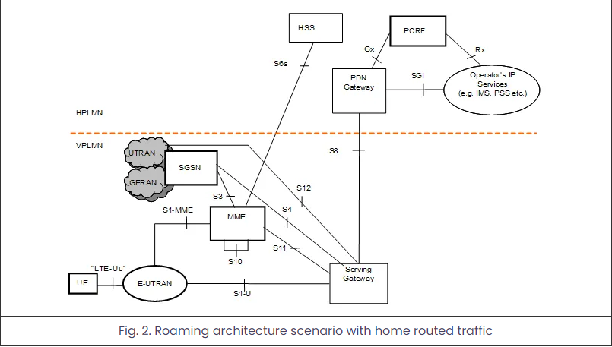
4G Roaming

Slide 9
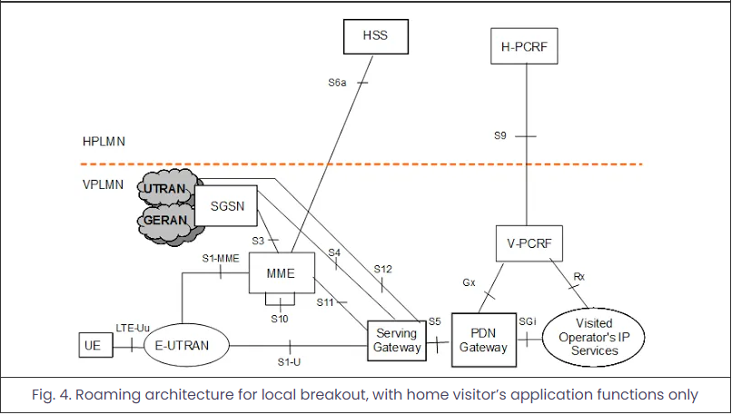
LBO

Slide 10
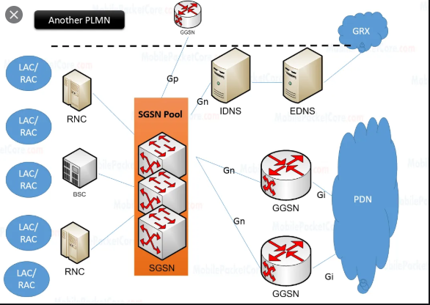
Gn DNS (Bishm Pitamaha of PACO) ➔ A and S records

Slide 11
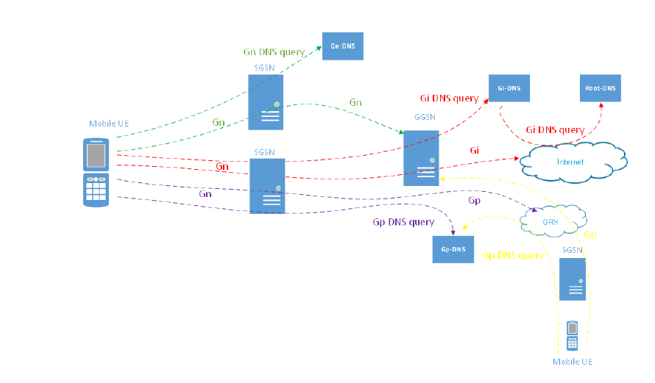
Types of DNS and its Flow

Slide 12
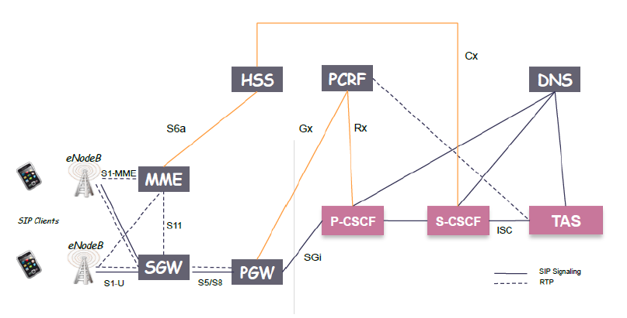
Volte Architecture

Slide 13
Protocols to learn
GTPU, GTPv2, GTP ➔ VIMP
TCP, UDP, SCTP
Diameter ➔ VIMP
SS7

Slide 14

Why we monitor Alarm , Gi , KPI
Tip : Check previous shift alarms too

Slide 15
Common Alarms and their importance
1. Gb link down ,RNC unreachable & S1AP enodb down
2. Gtpu alarms
3. Diameter link down
4. Gtpc path failure
5. Attach failure
6. PDP failure
7. High Temp and HW alarms
8. SS7 alarms

Slide 16
Basic Troubleshooting
1. Gx and Gy issue
2. SGSN to GGSN, MME to SGW reachability issue
3. Gi DIP issue (Need to consider SRV logic hence the overall traffic stats).
4. 4G Attach issue. 2g-3g attach and PDP issue.
5. Node Login issue .

Slide 17

Any Questions ?!?

